Slide 1
Introduction to Blueprints
Aerospace Manufacturing Core Study Guide
“AMCSG-301”
Blueprints & Documents

Slide 2
Introduction to Blueprints

Slide 3
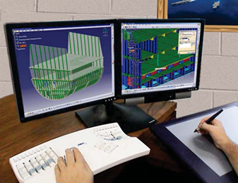
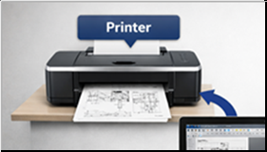
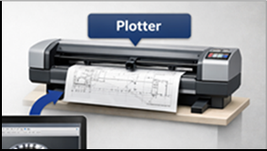
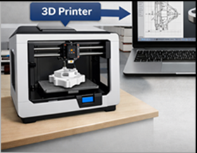
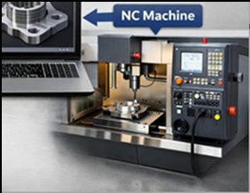
Definition of a Blueprint
Text from Google AI
Blueprint = Engineering Drawings = Technical Drawings = Plans (= Sketch)
Detailed drawings used all stages: design > manufacture > maintain aircraft
Modern drawings = CAD. Blueprint comes from old chemical process for copies
CAD drawings can then feed:
Printers
Plotters
3D Printers
NC Machines
(PD) U.S. Gov – NAVEDTRA14040A, 2015
(PD) U.S. Gov – NAVEDTRA14040A, 2015
Notes:
Google AI: “show me a picture of blueprints in the aerospace industry. describe all parts of a blueprint.”
US Govt Public Domain Doc Pictures: https://media.defense.gov/2017/Nov/03/2002658619/-1/-1/1/171103-N-ZY182-15347.pdf
ChatGPT: make me a picture showing a laptop with CAD that feeds data to 1) printer, 2) plotter, 3) 3D printer to create part, 4) NC Machine / direct numerical control

Slide 4
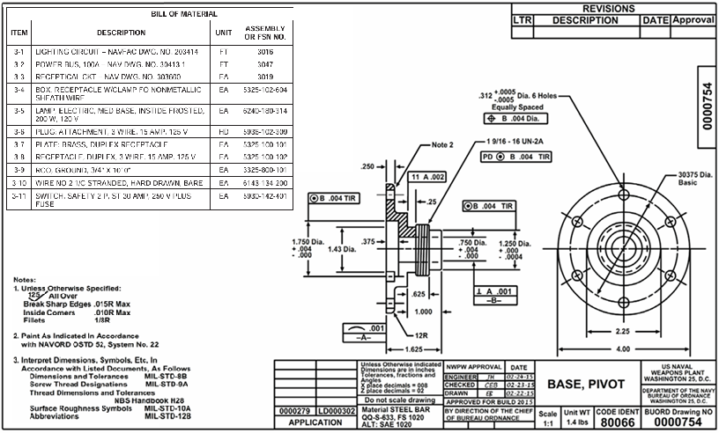
Blueprint “Standard Elements” (1 of 2)
Bill of Materials
Border
Revision Block
Drawing Area
Title Block
(PD) U.S. Gov – NAVEDTRA14040A, 2015
Notes:
ChatGPT query identified US Government public domain document: https://media.defense.gov/2017/Nov/03/2002658619/-1/-1/1/171103-N-ZY182-15347.pdf

Slide 5
Blueprint “Standard Elements” (2 of 2)
Blueprint Lines
Shape of objects from top, front, and side views
Features hidden inside an object
Measurement and callout lines
Blueprint Symbols
Hundreds of specific symbols
Representing Machining, Fasteners, Electrical, Hydraulic, Welding, etc.
Notes:
ChatGPT query identified USGovernment public domain document: https://media.defense.gov/2017/Nov/03/2002658619/-1/-1/1/171103-N-ZY182-15347.pdf

Slide 6
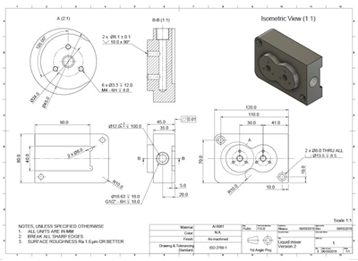
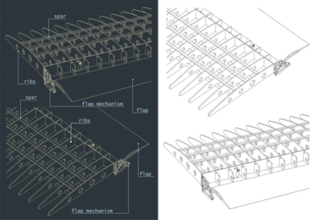
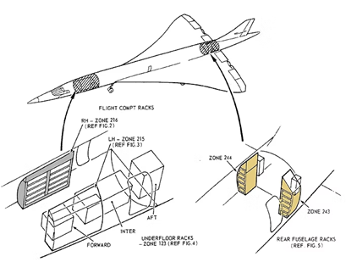
Drawing Types
Text from ChatGPT
Production Drawings - Engineers’ Instructions how to build
Detail Drawings - How to fabricate a specific part
Assembly Drawings - How an assembly is put together
Installation Drawings - Where parts & assemblies located in final product
Part
Assembly
Final Product
Part Detail Drawing
Assembly of Parts Drawing
Installation Drawing
ChatGPT / Matt Pierce, 2026
ChatGPT / Matt Pierce, 2026
ChatGPT / Matt Pierce, 2026
Notes:
ChatGPT for all three images: show an example each of "Detail Drawings", "Assembly Drawings", and "Installation Drawings". Focus on commercial aircraft as the context.

Slide 7
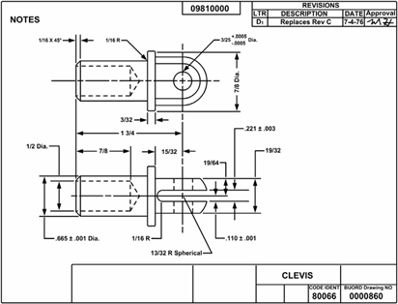
“Detail” Drawings
Text from ChatGPT
“Part Details” Drawing
Material Size Requirements
Heat-Treating Information
Machine Finish Requirements
Protective Finish Requirements
Process Specs & Standards
Part Number
Tolerance Info
Size & Shape Info
Hole Locations
(PD) U.S. Gov – NAVEDTRA14040A, 2015
Drawing Number
Notes:
ChatGPT query identified USGovernment public domain document: https://media.defense.gov/2017/Nov/03/2002658619/-1/-1/1/171103-N-ZY182-15347.pdf

Slide 8
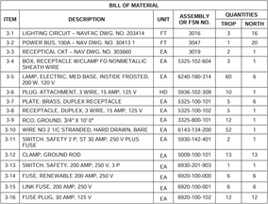
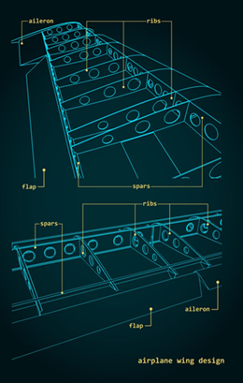
“Assembly” Drawings
Text from ChatGPT
“Assembly of Parts” Drawing
Part List
Information How Parts Fit Together
Part Number and Instructions
Location dimensions
Fastening Methods
(PD) U.S. Gov – NAVEDTRA14040A, 2015
ChatGPT / Matt Pierce, 2026
Notes:
ChatGPT: show examples of assembly drawings for aircraft manufacturing. include a part list, diagram how parts fit together, dimension lines, etc.
ChatGPT query identified USGovernment public domain document: https://media.defense.gov/2017/Nov/03/2002658619/-1/-1/1/171103-N-ZY182-15347.pdf

Slide 9
“Installation” Drawings
Text from Google AI
“Final Installation of Assemblies and Parts” Drawing
List of Required Component Parts
ChatGPT / Matt Pierce, 2026

Slide 10
Q&A

Slide 11
Practice Q&A’s (Q1-Q8)
Q5: Name of blueprint section listing changes made, by whom, etc.?
A: Revision Block
Q6: Name of blueprint section listing the drawing number, description, notes, scale, etc.?
A: Title Block
Q7: Name of blueprint section containing schematics, drawings, callouts, dimensions, etc.?
A: Drawing Area
Q8: Name encompassing the Details Drawings, and the Assembly Drawings, and the Installation Drawings?
A: Production Drawings
Q1: General name covering the engineering drawings, technical drawing, or plans?
A: Blueprints
Q2: Modern blueprints are no longer hand drawn...what is the name of the software used?
A: CAD: Computer Aided Drafting
Q3: Both CAD and blueprints enabled duplicating drawings. But what more can CAD do?
A1: Send to 3D printer to create a part.
A2: Send to NC machine to mill a part.
Q4: Name of blueprint section listing materials and parts used on the drawing?
A: Bill of Materials

Slide 12
Practice Q&A’s (Q9-Q8)
Q13: When you put together Ikea furniture by following the instruction manual, what is it?
A: Installation Drawing because parts already created, and sub-assemblies like latches and hinges already built. You are just installing it all together.
Q14: What type of drawing contains material size requirements, heat-treating info, and machine finish requirements?
A: Detail Drawings
Q9: Type of drawing showing how to fabricate a specific part?
A: Detail Drawing
Q10: Type of drawing showing how to assemble the parts into a component?
A: Assembly Drawing
Q11: Type of drawing showing where parts and assemblies go in final product?
A: Installation Drawing
Q12: What type of drawing contains part list, part numbers, location dimensions, and fastening methods?
A: Assembly Drawings

Slide 13
Thank You
Matt Pierce - mpierce710006@gmail.com - linkedin.com/in/mpiercead576/
https://github.com/DataResearchLabs/study_guide_intro_aerospace_mfg

